Slide 1

Analysis: Credit Card Utilization Predictors
By
Kevin Appiah
May 16,2023
This Photo by Unknown Author is licensed under CC BY-ND

Slide 2

Introduction
Introduction of Dataset
The dataset used to perform this analysis this dataset consists of 10,000 customers with variables; age, salary, marital status, credit card limit, credit card category, etc. There are nearly 18 features.
Purpose: This analysis aims to investigate the relationship between customer age, credit limit, revolving balance, and credit card utilization. The goal is to
Goal: Understanding how these variables collectively influence credit card usage patterns among customers.
Question
Is there a significant relationship between customer age, credit limit, and revolving debt on the average credit card utilization ratio?

Slide 3

Statistical Methods
A multiple linear regression model was used to estimate the effect of customer age, credit limit, and revolving balance on the average utilization ratio of credit cards. This approach offers a more comprehensive analysis compared to a simple linear regression, as it considers multiple influencing factors simultaneously, which should provide a better fit for the dataset.
Hypothesis Formulation: Introduce the null and alternative hypotheses for the predictors.

Slide 4
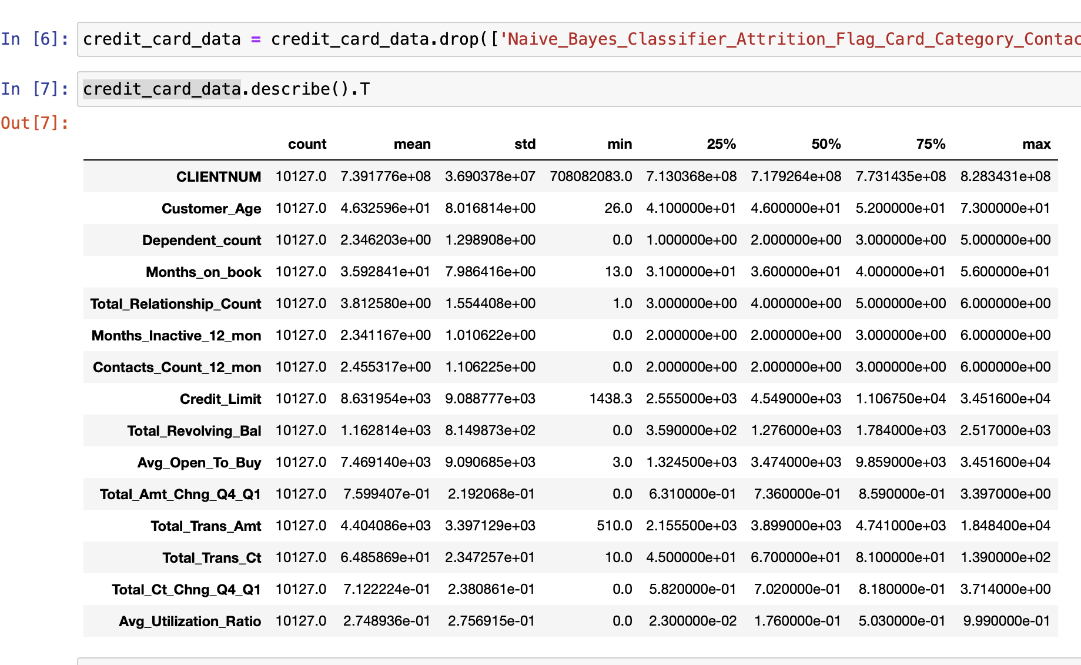
Exploratory Data Analysis
The statistical description of the data was retrieved from the data set by using the describe function to gain more insight into the data such as the mean, standard deviation, minimum and maximum.

Slide 5
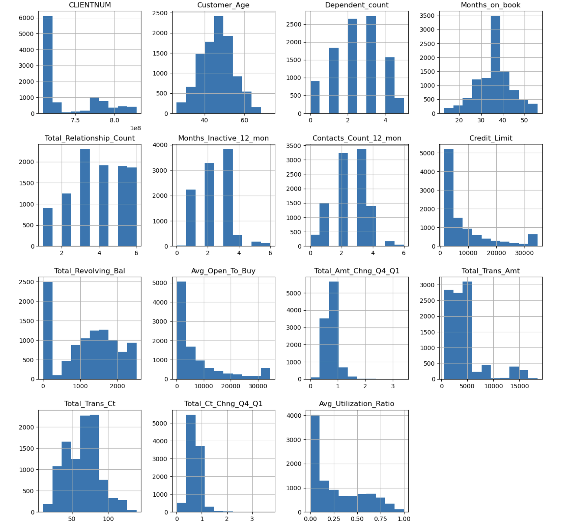
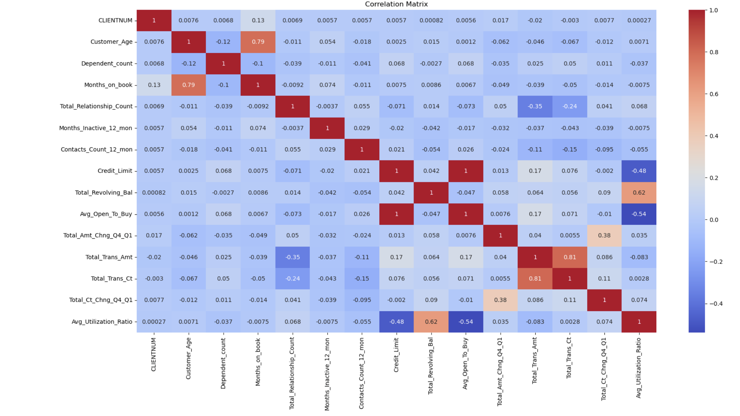
Data Visualization
Histograms for each variable in the dataset to gain a fair knowledge of their distributions. Special attention was paid to the independent variables ('Customer Age', 'Credit Limit', and 'Total Revolving Balance') and the dependent variable ('Average Utilization Ratio').
The correlation matrix helped us understand which column types will serve our purpose and which do not. The column types that had many false positives usually ended up being the less reliable and unnecessary values.

Slide 6
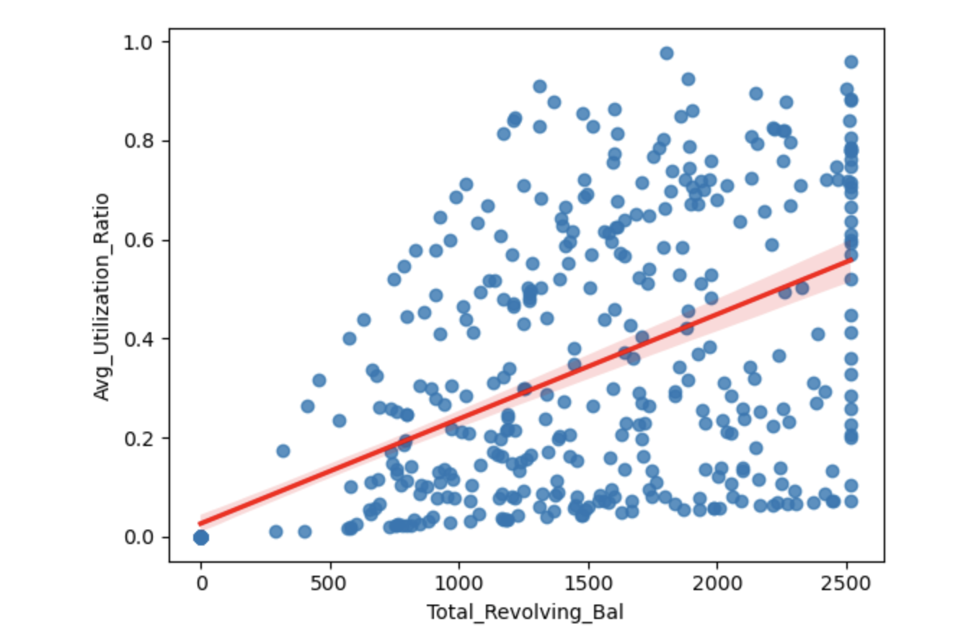
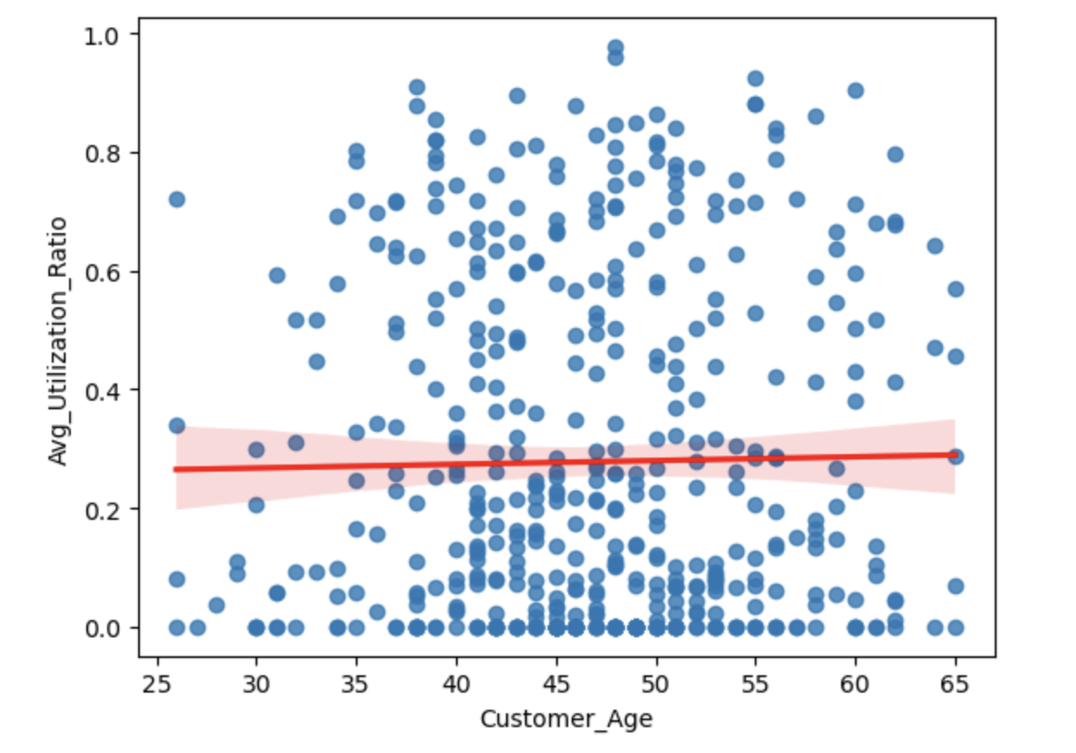
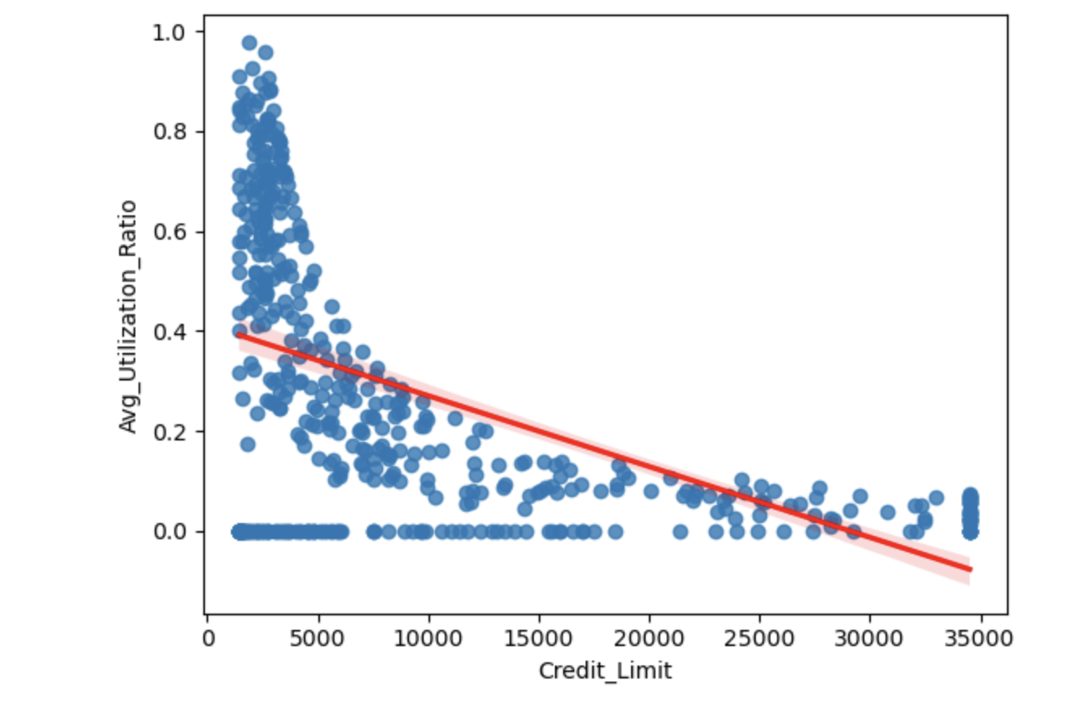
Data Visualization
These scatter plots of credit limit, age, and total revolving balance against credit card utilization.
The scatterplot between 'Total Revolving Balance' and 'Average Utilization Ratio' displays a clear upward trend, in line with the strong positive correlation
The scatterplot between 'Customer Age' and 'Average Utilization Ratio' reveals an almost random distribution of points, underscoring the weak correlation
The scatterplot between 'Credit Limit' and 'Average Utilization Ratio' shows a moderate downward trend, reflecting the negative correlation.

Slide 7
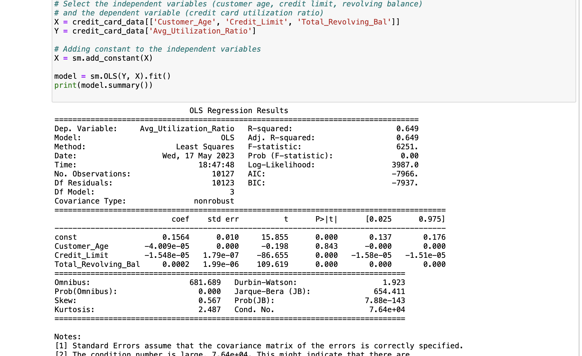
Multiple Linear Regression
Regression results
The R-squared value is 0.649, which means our model explains 64.9% of the variance in the average credit card utilization ratio.
The coefficient of Customer_Age is -4.009e-05. This means that for each one-year increase in age, we would expect the Average Utilization Ratio to decrease by 0.00004009 units, holding all other factors constant.
The coefficient of Credit_Limit is -1.548e-05. This implies that for each one-unit increase in the Credit Limit, we would expect the Average Utilization Ratio to decrease by 0.00001548 units, assuming all other variables remain the same.
The coefficient of Total_Revolving_Bal is 0.0002. This suggests that for each one-unit increase in the Total Revolving Balance, we would expect the Average Utilization Ratio to increase by 0.0002 units, assuming all other variables are held constant.

Slide 8
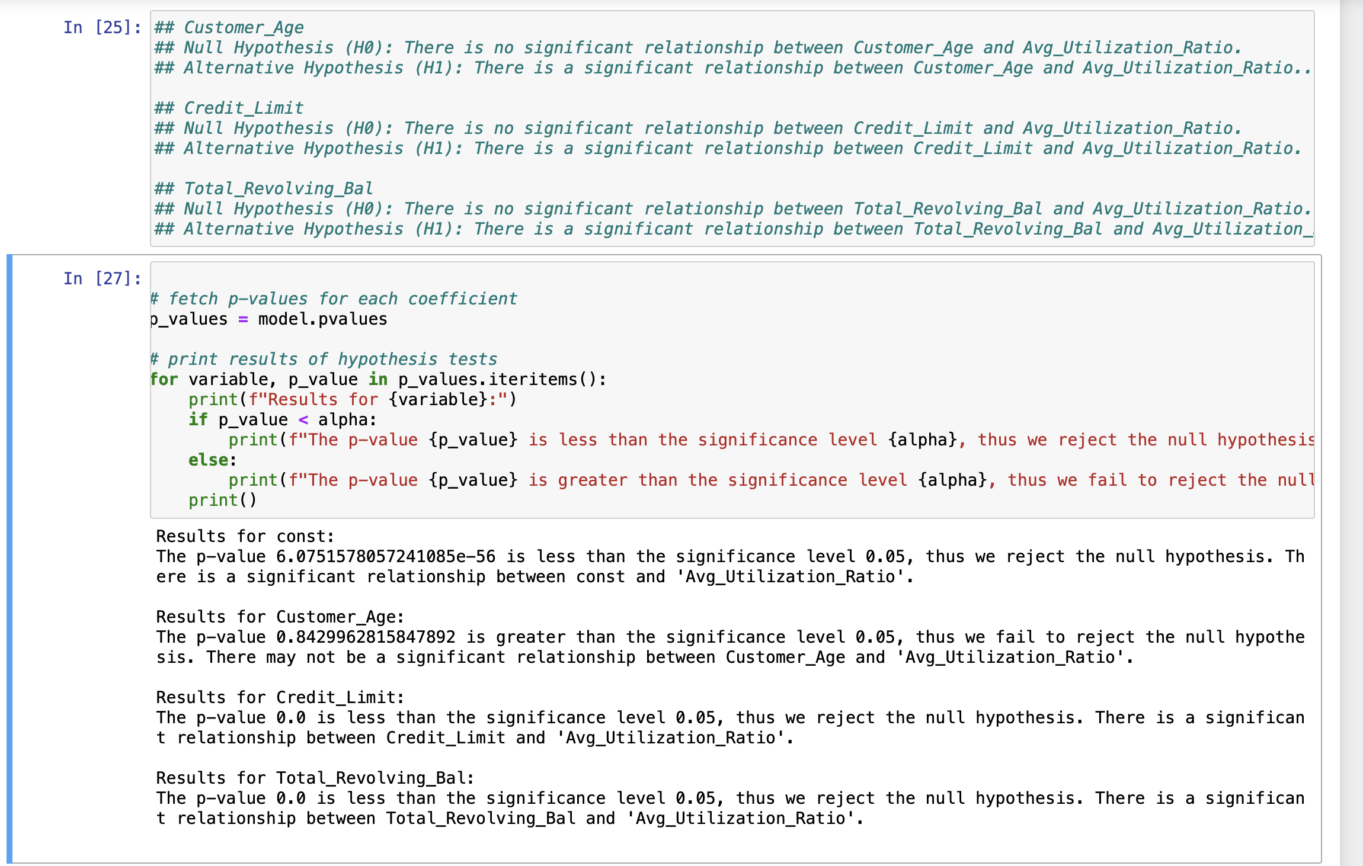
Hypothesis Testing
P-values in this regression context help us to identify which variables are significant predictors of the outcome variable, which can be useful in feature selection and model interpretation
Hypothesis testing using the p values obtained from the OLS regression results with a significance level of 0.05
Customer Age: Fail to reject the null hypothesis, as p-value > 0.05.
Credit Limit and Total Revolving Balance: Reject the null hypothesis, as p-value < 0.05.

Slide 9

Conclusion
The analysis revealed significant relationships between the 'Average Utilization Ratio' and both 'Credit Limit' and 'Total Revolving Balance'. As the credit limit increases, the average utilization ratio decreases, suggesting customers with higher limits don't typically use a large portion of their available credit. Conversely, higher revolving balances correlate with higher average utilization ratios. However, 'Customer Age' showed no statistically significant influence on credit card utilization, indicating age does not notably impact these usage patterns.
These insights could prove valuable for financial institutions in developing strategies to manage credit risk and improve customer service.

Slide 10

This Photo by Unknown Author is licensed under CC BY-SA-NC

Slide 11

This Photo by Unknown Author is licensed under CC BY

Slide 12
References
Data to fish. Data to Fish. (n.d.). https://datatofish.com/statsmodels-linear-regression/
Chauhan, A. (2022a, October 30). Credit card customers prediction. Kaggle. https://www.kaggle.com/datasets/whenamancodes/credit-card-customers-prediction
rsundery. (2022, February 14). Interpreting the results of linear regression using OLS summary. GeeksforGeeks. https://www.geeksforgeeks.org/interpreting-the-results-of-linear-regression-using-ols-summary/

